Slide 1

Gen AI Prompt Engineering
By

Slide 2
Components of prompt
1. Role (Who the AI should be?)
Defines the persona, expertise, or perspective the AI should assume while responding. This helps control tone, depth, and style of the output.
Example: “You are a subject-matter expert in artificial intelligence explaining concepts to beginners.”
2. Task (What needs to be done?)
The overall objective or purpose of the prompt. Clearly states what the AI is expected to accomplish.
Example: “Generate a summary of an article.”
3. Instruction (How should the task be performed?)
Specifies how the task should be executed, including rules, limits, or style.
Example: “Summarize the article in no more than 100 words, keeping the key points intact.”
Role
Task
Instruction
Input
context
Output Format
Action or process
Rules to process
Actual content, dataset, image
Background Info
How response look
Who is AI
Notes:
Role – Who the AI should be
Task – What needs to be done
Instruction – How it should be done
Input – Data to operate on
Context – Background / constraints / audience
Output Format – How the response should look (optional but useful)
You are a professional chef.
Cook a dish using the given ingredients.
Prepare a simple, step-by-step recipe suitable for beginners.
Ingredients: tomatoes, onions, garlic, olive oil, salt.
The dish should be vegetarian and light.
Present the recipe in numbered steps with a serving suggestion.

Slide 3
Components of prompt
4. Input (What data is provided to perform the task?)
The actual content or information on which the AI operates.
Example: “The article text: ‘AI is transforming industries by automating tasks…’”
5. Context (Additional details that help improve accuracy)
Background information, constraints, target audience, or usage scenario that refines the response.
Example: “This summary is intended for a general audience with no technical background.”
6. Output Format (How should the response look?)
Defines the structure, layout, or presentation style of the final output.
Example: “Present the summary as a single paragraph using simple language.”
“Get the change for 1000 in 100 rupees notes”
Role
Task
Instruction
Input
context
Output Format
Action or process
Rules to process
Actual content, dataset, image
Background Info
How response look
Who is AI
Notes:
Role – Who the AI should be
Task – What needs to be done
Instruction – How it should be done
Input – Data to operate on
Context – Background / constraints / audience
Output Format – How the response should look (optional but useful)
You are a professional chef.
Cook a dish using the given ingredients.
Prepare a simple, step-by-step recipe suitable for beginners.
Ingredients: tomatoes, onions, garlic, olive oil, salt.
The dish should be vegetarian and light.
Present the recipe in numbered steps with a serving suggestion.

Slide 4
Prompt Example 1
Role:
You are an experienced computer science trainer who explains technical topics in a simple way.
Task:
Explain the given concept clearly.
Instruction:
1. Start with a simple definition.
2. Explain the concept step-by-step.
3. Provide a real-world analogy.
4. Give a short example.
Input:
Concept: Neural Networks
Context:
The explanation is for beginners who have no background in artificial intelligence.
Output Format:
Definition:
<simple definition>
Explanation:
<step-by-step explanation>
Analogy:
<real-world analogy>
Example:
<short example>
Notes:
Role – Who the AI should be
Task – What needs to be done
Instruction – How it should be done
Input – Data to operate on
Context – Background / constraints / audience
Output Format – How the response should look (optional but useful)
You are a professional chef.
Cook a dish using the given ingredients.
Prepare a simple, step-by-step recipe suitable for beginners.
Ingredients: tomatoes, onions, garlic, olive oil, salt.
The dish should be vegetarian and light.
Present the recipe in numbered steps with a serving suggestion.

Slide 5
Prompt Example 2
Role: You are a professional data analyst specializing in retail analytics. Task: Analyze the sales data and identify the best and worst performing products. Instruction: 1. Determine the product with the highest revenue. 2. Determine the product with the lowest revenue. 3. Provide one insight about the sales trend. Input: Product A – Revenue: $5000 Product B – Revenue: $2000 Product C – Revenue: $7000 Product D – Revenue: $1500 Context: The analysis will be shown to a retail store manager who wants quick insights to improve product sales. Output Format: Top Product: <product name> – <revenue> Lowest Product: <product name> – <revenue> Key Insight: <short explanation>
Notes:
Role – Who the AI should be
Task – What needs to be done
Instruction – How it should be done
Input – Data to operate on
Context – Background / constraints / audience
Output Format – How the response should look (optional but useful)
You are a professional chef.
Cook a dish using the given ingredients.
Prepare a simple, step-by-step recipe suitable for beginners.
Ingredients: tomatoes, onions, garlic, olive oil, salt.
The dish should be vegetarian and light.
Present the recipe in numbered steps with a serving suggestion.

Slide 6
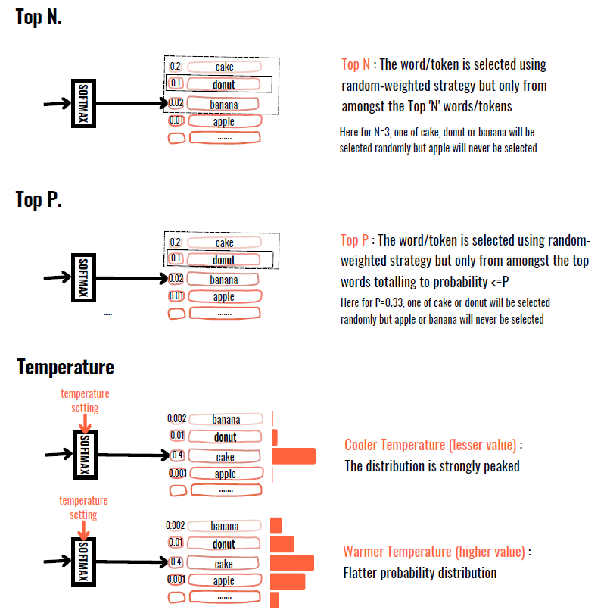
Prompt parameters

Slide 7
Terminology
Term | Meaning
Prompt | Instructions + context; what you send to the model
Generated output | Tokens the model produces
Context window / Max sequence length | Total tokens model can handle at once = prompt + output
max_tokens / max_output_tokens | Limits how long the model output can be; must fit inside context window
Sampling Parameters | temperature, top-p, max_output_tokens

Slide 8
Prompt Engineering
Prompt Engineering is the art of designing inputs for LLMs (like ChatGPT) to obtain desired responses.
Prompt Engineering Techniques :
Zero-Shot Prompting
Few-Shot Prompting
Chain-of-Thought (CoT) Prompting
ReAct (Reasoning + Acting)
Self-Consistency
Instruction-Based Prompting
Role-Based Prompting

Slide 9
Zero Shot Prompting
Concept
Zero-shot prompting relies on the model’s pre-trained knowledge to answer queries without providing examples.
Example
Prompt: "What is the capital of France?"
ChatGPT Response: "The capital of France is Paris."
Use Case:
Simple fact-based queries
General knowledge retrieval
Limitations:
Struggles with tasks requiring context or reasoning

Slide 10
Few Shot Prompting
Concept
Providing a few examples to guide the model on the desired format and reasoning.
Example
Prompt: "Classify the following texts as Positive or Negative sentiment:
'I love this product!' → Positive
'This is the worst experience ever!' → Negative
'I am very happy with my purchase.' → ?"*
ChatGPT Response: "Positive.“
Use Case:
Sentiment analysis
Text classification
Pattern learning
Limitations:
Requires carefully selected examples

Slide 11
Chain of Thought (CoT)
Chain-of-Thought (CoT) Prompting
Concept
Encouraging the model to break down reasoning into intermediate steps before answering.
Example
Prompt: "A farmer has 3 baskets. Each basket contains 5 apples. If he gives away 4 apples, how many apples remain? Let's think step by step.“
ChatGPT Response: "Step 1: The farmer starts with 3 baskets × 5 apples = 15 apples. Step 2: He gives away 4 apples. Step 3: 15 - 4 = 11 apples remain. Final Answer: 11 apples.“
Use Case:
Complex math problems
Logical reasoning tasks
Limitations:
Requires structured reasoning tasks

Slide 12
ReAct
ReAct (Reasoning + Acting) Reason → Action → Observation → Response
Concept
Combining reasoning with action by making the model think, retrieve, and act iteratively.
Example
Prompt: "Who won the 2023 FIFA World Cup? Think step by step and search if needed.“
ChatGPT Response (simulating ReAct): "Step 1: The last FIFA World Cup was held in 2022, and Argentina won. Step 2: Let me check the 2023 winner (simulated search). Step 3: The 2023 FIFA Women's World Cup was won by Spain. Final Answer: Spain won the 2023 FIFA Women's World Cup.“
Use Case:
Dynamic decision-making
Research-based reasoning
Limitations:
Needs external search for live data
Notes:
Thought: I need to find who won the 2023 FIFA World Cup.
Action: Search["2023 FIFA World Cup winner"]
Observation: The search result says Argentina won the 2022 World Cup; 2023 was a Women's World Cup, won by Spain.
Thought: Therefore, the answer is Spain.
Final Answer: Spain

Slide 13
Self-Consistency
Run the same prompt multiple times
Example
Prompt: "If a train travels 100 miles in 2 hours, what is its speed?
or
"If a train travels 100 miles in 2 hours, what is its speed? Solve using two different methods.“ <not exactly a self consistency)
ChatGPT Response: Method 1: "Speed = Distance ÷ Time = 100 miles ÷ 2 hours = 50 mph."
Method 2: "If the train covers 100 miles in 2 hours, in 1 hour it covers 50 miles. So, the speed is 50 mph."
"Final Answer: 50 mph.“
Use Case:
Reducing hallucinations in reasoning tasks
Improving mathematical accuracy
Limitations:
Can be computationally expensive
Notes:
You run the same prompt multiple times — for example, n = 10 completions using the same model.
Each run is slightly different because you set temperature > 0 (so the model explores multiple reasoning paths).
You then collect all the outputs — say, 10 possible answers or reasoning chains.
You analyze those results yourself (outside the model) — this could be done via:
A simple majority vote on the final answer (most common result wins), or
A scoring function that checks which answer best fits certain criteria (e.g., numerical accuracy).
The model itself doesn’t decide which is best — you (or your code) do that selection.

Slide 14
Other useful Techniques
Instruction-Based Prompting
Instead of a vague query, clearly instruct the model.
Example ❌ "Summarize this article." ✅ "Summarize this article in three bullet points, each under 20 words.“
Role-Based Prompting
Assigning a persona to the model to align responses.
Example "You are a cybersecurity expert. Explain the importance of multi-factor authentication in banking security.“
By using these techniques, you can significantly improve LLM’s responses for different use cases like NLP tasks, logical reasoning, and automation

Slide 15
Thank you

